Slide 1

The FADE Score:
(Functional Athleticism in a Development Environment)
By: Adithya Prabakaran

Slide 2
Project Construction: Background
Prompt:
Develop a player forecasting model using East-West Bowl game data, practice data, and/or college stats to forecast a player’s likelihood to play or his rookie season performance.
Player Evaluation Process:
Player Tracking Data Can:
Verify that athleticism projects to next level.
Provide insight on prospect athletic profile.
Game Film Data Can:
Contextualize functional athleticism in a competitive environment.
“How was a player’s functional athleticism utilized by a coaching staff?”
Goal:
Input:
Calculate speed, acceleration, and distance from simulated football movement weighed with college production.
Output:
A metric to model stability in production over a rookie contract.
FADE Score
(Functional Athleticism in a Developmental Environment)

Slide 3
Project Construction: Context
Project Overview
Information Gathered in Evaluation Process:
Character/Background
College Production
Game Film Insights
GPS Tracking Data
When projecting a prospect, the strongest correlations to success at the next level are character and functional athletic ability, not production.
If you invest in an asset with a lower athletic ceiling, how likely are you to develop the asset to provide a surplus return on investment?
Base of Athletic Profile:
Acceleration
Short-Area Quickness
Foot Speed
Problems With NFL Scouting Combine Events That Test Athletic Profile:
Timed and Measured Events aren’t simulated-football movements
Drills require a nuanced lens to fully grasp, good and bad
How do we quantify or qualify a player’s athletic floor? A 40-yard dash doesn’t matter if a defensive tackle can’t convert that speed to power for a bull-rush.
Example Simulated Football Movements:
Run Through Hole of Inside Zone
Bull Rush OT From W9 Alignment
Spot Drop Into Zone and Transition to Thrown Ball
Movements are often intended to stress or create leverage. My project aims to contextualize how well prospects can stress or create leverage by calculating their:
Play Speed
Play Acceleration
Movement efficiency

Slide 4
Project Construction: Philosophy
What information will I be using?
Player Tracking Data:
I primarily want to evaluate functional athleticism. Player tracking data allows us to calculate average speed, acceleration, and displacement across all positions except QB.
These movements are captured from:
2024 “Team” practice periods
2024 and 2025 East–West Shrine Bowl game data
2022 Practice Data (Used for Validation)
By focusing on football-specific movement, the model isolates how athletic traits present during realistic, repeatable actions rather than isolated testing scenarios.
Each metric is standardized using position-specific z-scores. Then, I take the average of all 6 z-scores to create this part of the metric, meant to emphasize consistency and repeatability of movement.
Weight in FADE score: 0.75
College Production:
College production, much like game film, serves as evidence that a prospect’s functional athletic profile has been utilized within a competitive environment. However, production is heavily influenced by development context, role, and opportunity. It doesn’t consistently translate across levels of play.
Prospects participating in all-star exhibitions are often multi-year college contributors that are looking to elevate or solidify their draft stock; they’re likely to be below-average producers relative to their peers who project to be selected in the early rounds of the draft. In the event someone with above-average production is participating, they’re typically viewed as a marquee prospect. In addition, All-Star games provide similar levels of competition; this is important for smaller school prospects looking to validate their functional athleticism in front of scouts and executives.
Given these factors, college production is a proportionally lower weight than the player tracking data. This approach preserves production as a contextual indicator while maintaining athletic translation as the primary driver of the evaluation.
Weight in FADE score: 0.25

Slide 5
Testing Functional Speed, Strength, & Length
Functional Athleticism Testing Parameters:
Play Speed
Quick Twitch &
Speed To Power Conversion
Movement Efficiency
Is made up of:
Is made up of:
Is made up of:
Foot Speed
Acceleration
Explosiveness
Short-Area Quickness
Balance
Agility
List of Athletic Traits:

Slide 6
Testing Functional Speed, Strength, & Length
Per player and simulated football movement, what are we trying to find in the player tracking data?
Play Speed: How much displacement was covered by a prospect in how much time.
Quick Twitch/Speed to Power: How quickly a player gets out of stance/generates significant power.
Movement Efficiency: How tight of a path a player adheres to when moving.
Information Collected Per Movement:
Play Speed
Average Speed
75th Percentile Speed
Max Speed
Quick Twitch
Speed To Power Conversion
95th Percentile Acceleration
Max Acceleration
Movement Efficiency
Wasted Displacement Ratio

Slide 7
Score Calculation
Averages Per Player
Averaged
Functional Athleticism Z-Score
0.75
Average Speed
Z-Score
75th Percentile Speed
Z-Score
Averaged Production Z-Score
0.25
Max Speed
Z-Score
95th Percentile Acceleration
Z-Score
Adjusted Weighed Z-Score
Max Acceleration
Z-Score
Ranked by Position w All EWS participants
Wasted Displacement Ratio
Z-Score
FADE Score (Out of 100)

Slide 8
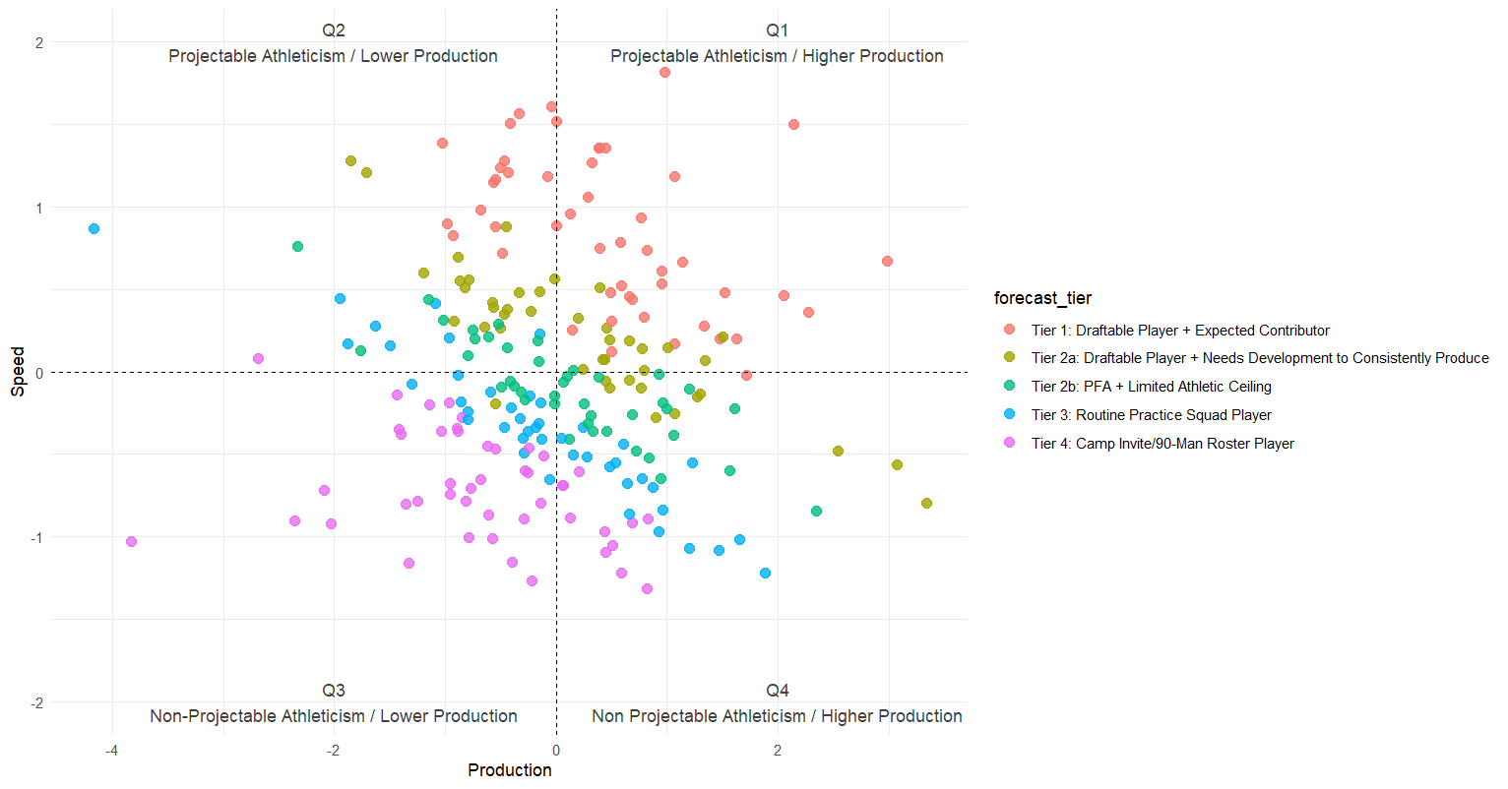
Player Projection & Tiering: Modeling
Player Tiering System
Needs developmental opportunities to eventually produce
Expect some production regardless of snap count (67% Hit Rate)
Tier 1
FADE Score
Draftable Player – High-certainty producer over rookie contract
100
80
60
40
20
Mix of Tier 2a & 2b Participants
Tier 1 Participants
Tier 2a
Draftable Player – Game day contributors / Players with upside
Tier 2b
Priority FA – Game day contributors / Players with limited athletic ceiling
Tier 3
UDFA – Likely Practice Squad / Emergency depth players
Mix of Tier 3 & 4 Participants
Mix of Tier 2b & 3 Participants
Tier 4
90 Man Roster – Athleticism doesn’t project to NFL
Little stable production despite increased opportunities
Production is dependent on ideal scheme-fit

Slide 9
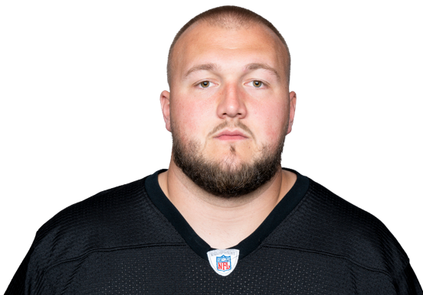
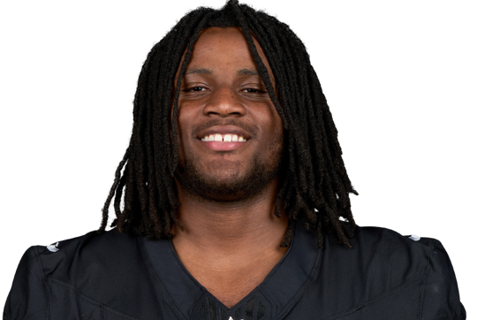
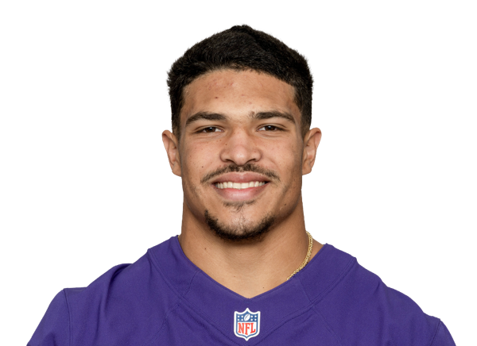
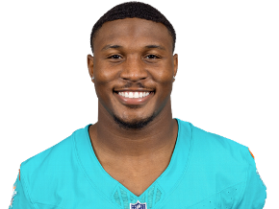
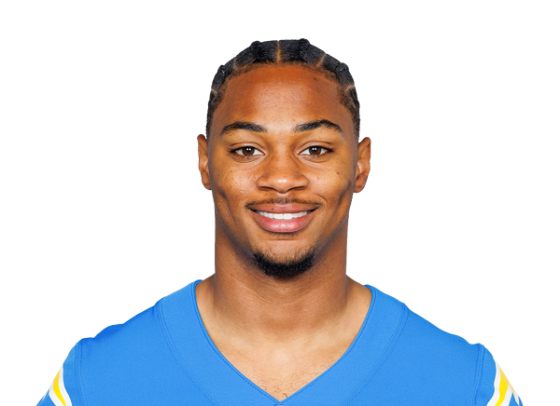

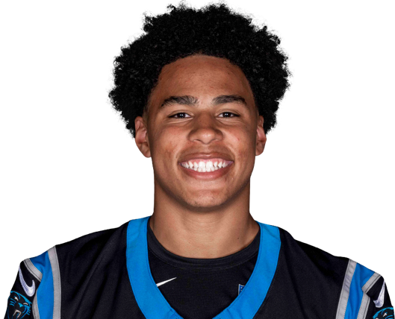

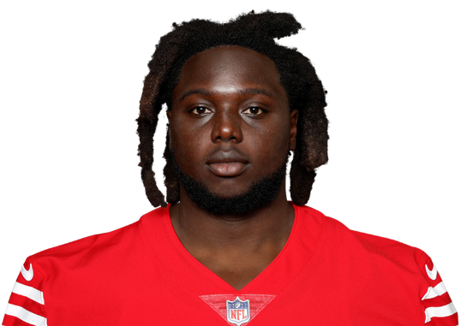
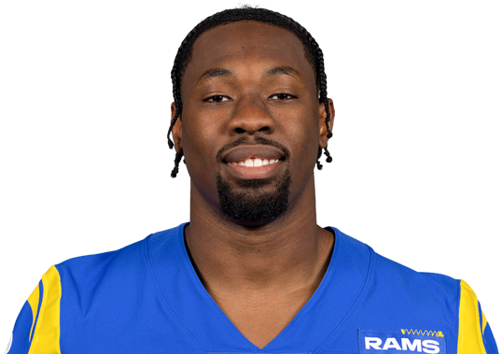

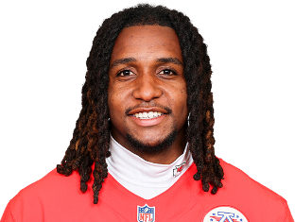

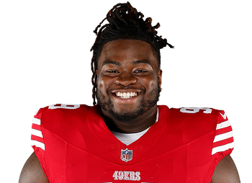
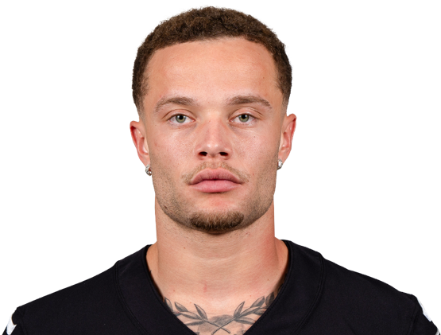
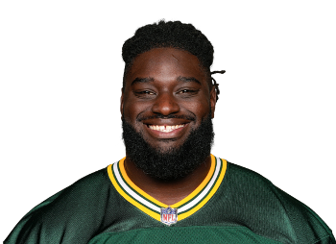
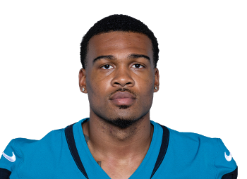
Player Projection & Tiering: Examples
Best Performers In Each Tier of FADE (‘24 & ‘25 Classes)
Player Tiering System
Tier 1
FADE Score
Draftable Player – High-certainty producer over rookie contract
100
80
60
40
20
Mason McCormick Tonka Hemingway Teddye Buchanan Malik Washington
100.0 100.0 95.45 93.75
Tier 2a
Draftable Player – Game day contributors / Players with upside
Tarheeb Still Tyrone Tracy Jalen Coker Isaiah Williams
75.76 61.11 74.19 65.63
Tier 2b
Priority FA – Game day contributors / Players with limited athletic ceiling
Evan Anderson Josh Wallace Caedan Wallace Nohl Williams
56.00 48.48 36.00 45.45
Tier 3
UDFA – Likely Practice Squad / Emergency depth players
Zion Logue CJ West Casey Washington
Tier 4
36.00 24.00 32.26
90 Man Roster – Athleticism doesn’t project to NFL
Nazir Stackhouse Jarrian Jones
8.0
9.09

Slide 10
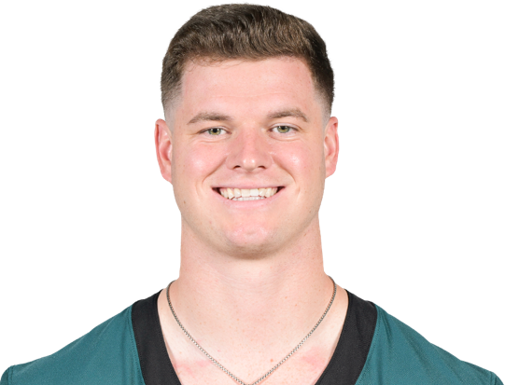
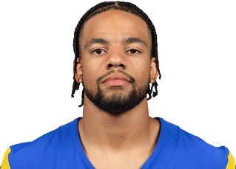
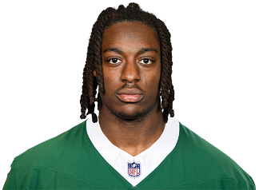
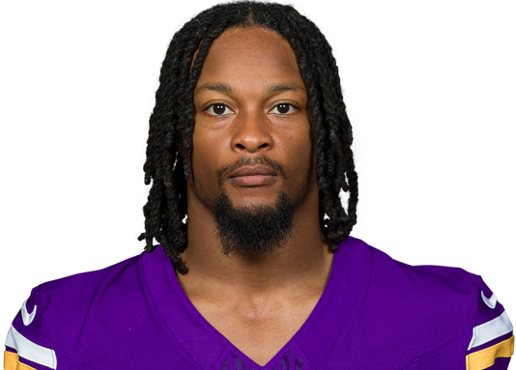
Model Validation: Player Tiering & NFL Outcome Signal
From 2017-2025:
34% of Shrine Bowl Participants have been drafted.
  Near 50% for IDL, IOL
  Near 15% for RB, ILB
Draftable player cut-off is 60.00 to match draft percentage
Value of FADE Score:
Flag instances where athletic testing data doesn’t correlate with on-field success
Player Tiering System
Tier 1
FADE Score
Draftable Player – High-certainty producer over rookie contract
100
80
60
40
20
2022 NFL Draft Class Study – EWS FADE Score Testing
Tier 2a
Prospect Hit = Prospect Produces Above Class Median (Amongst EWS Participants)
Draftable Player – Game day contributors / Players with upside
40-100 FADE Score Qualifiers:
70% Hit Rate
30% Higher Probability of “Hitting” on a Prospect
0-39.99 FADE Score Qualifiers:
40% Hit Rate
27% Hit Rate on Tier 4 Prospects
Tier 3 prospects project to be valuable on practice squads or special teams.
  2022 Class Hit Rate: 56%
Tier 2b
Priority FA – Game day contributors / Players with limited athletic ceiling
Model Values
Tier 3
Reed Blankenship
88.00
Cobie Durant
84.85
UDFA – Likely Practice Squad / Emergency depth players
R = 0.35 | p = 0.009
FADE Score shows a meaningful relationship with NFL Career Production, explaining ~12% of variance in a multi-year, high-noise outcome.
Model Cautions
Tier 4
Jelani Woods
26.67
Ty Chandler
5.56
90 Man Roster – Athleticism doesn’t project to NFL
Both Woods and Chandler tested well at their Combine/Pro Days. FADE Score can help differentiate functional athleticism from athletic testing as both aren’t necessarily the same thing.

